Slide 1
Off Grid communications with Android
- Meshing the mobile world
m0nk and stoker have fun @ DefCon 20

Slide 2
Who are you guys?
m0nk – Josh Thomas
jthomas@accuvant.com
m0nk.omg.pwnies@gmail.com
Stoker – Jeff Robble
jrobble@mitre.org
mistr.stoker@gmail.com
We work(ed) @ The MITRE Corporation (of CVE fame)
Notes:
m0nk & Stoker

Slide 3
tl; dr:
https://github.com/monk-dot
Notes:
m0nk

Slide 4
A placeholder so m0nk can babble
Notes:
m0nk asks why we need another Mesh talk?
If you do mesh and I don’t mention you, please don’t get pissed. Instead, email me and we can chat.
If all you want to do is WiFi tether, please don’t… it’s cool I guess, but really boring.

Slide 5
Where data goes to die
Fukushima
Katrina
Haiti
< Insert your “favorite” recent natural disaster here >
Other?
Notes:
m0nk

Slide 6
Why do I care about Mesh networks?
Physical infrastructure is prone to failure, networks shouldn’t be
Bypass the Cellular networks
Bypass Wi-Fi networks
Share information when infrastructure is broken or untrustworthy
Extend and bounce other networks via bridging / tethering
Headless
Notes:
m0nk

Slide 7
Ok, kind of cool. What about “Off Grid”?
Single point of failure = single point of sniffing / filtering
I don’t trust someone else being able to turn off my network, do you?
When you want to share info, but don't want anyone watching ☺
Notes:
m0nk

Slide 8
There should really be a funny pic below
Notes:
m0nk talks about Kansas City

Slide 9
Your pocket contains more than a consumption device for Grumpy Fowl
Wi-Fi chip with a fairly fat pipe
Cell modem and baseband processor
A ton of sensors
(Somewhat) quality NAND and RAM
A very under clocked and underutilized processor
Power
A boring screen that blinks!
Notes:
m0nk

Slide 10
The SPAN framework
We did the boring stuff so you don’t have to!
General Overview of the framework, what / why / how
Harnessing SPAN for your own project?
Repurpose root to muck with your Wi-Fi chipset
Notes:
Next 10 minutes overview slide

Slide 11
SPAN + Android Technical Architecture
Blinkie on a Map
P2P Chat App.
Other App.
Java Networking Interface
TCP Socket
UDP Socket
Reliable Transmission Layer
Security Manager
Session Manager
MANET Service
Network Configuration
Manual Routing Protocol Selection
Automated Routing Protocol Selection
Modular MANET Routing Protocol Framework
Proactive Routing Protocol Manager
Reactive Routing Protocol Manager
OLSR
BATMAN
Protocol 3
DSR
Protocol 2
Protocol 3
Transparent Proxy
iptables / netfilter
Linux Kernel Routing
Notes:
Stoker
OLSR – Optimized Link State Routing
BATMAN - Better Approach To Mobile Ad-hoc Networking
DSR – Dynamic Source Routing
tproxy is based on monoutil and requires netfilter queue rules setup by iptables to direct packets to it

Slide 12
Data Flow
P2P Chat App.
“Hello!”
P2P Chat App.
Java Networking Interface
Java Networking Interface
Transparent Backend
Transparent Proxy
Transparent Proxy
Transparent Proxy
Reliable Transmission Layer
Reliable Transmission Layer
Reliable Transmission Layer
MANET Routing Protocol
MANET Routing Protocol
MANET Routing Protocol
[determine route]
[update network topology / determine route]
[update network topology]
Source Node
Relay Node
Destination Node
Notes:
Stoker

Slide 13
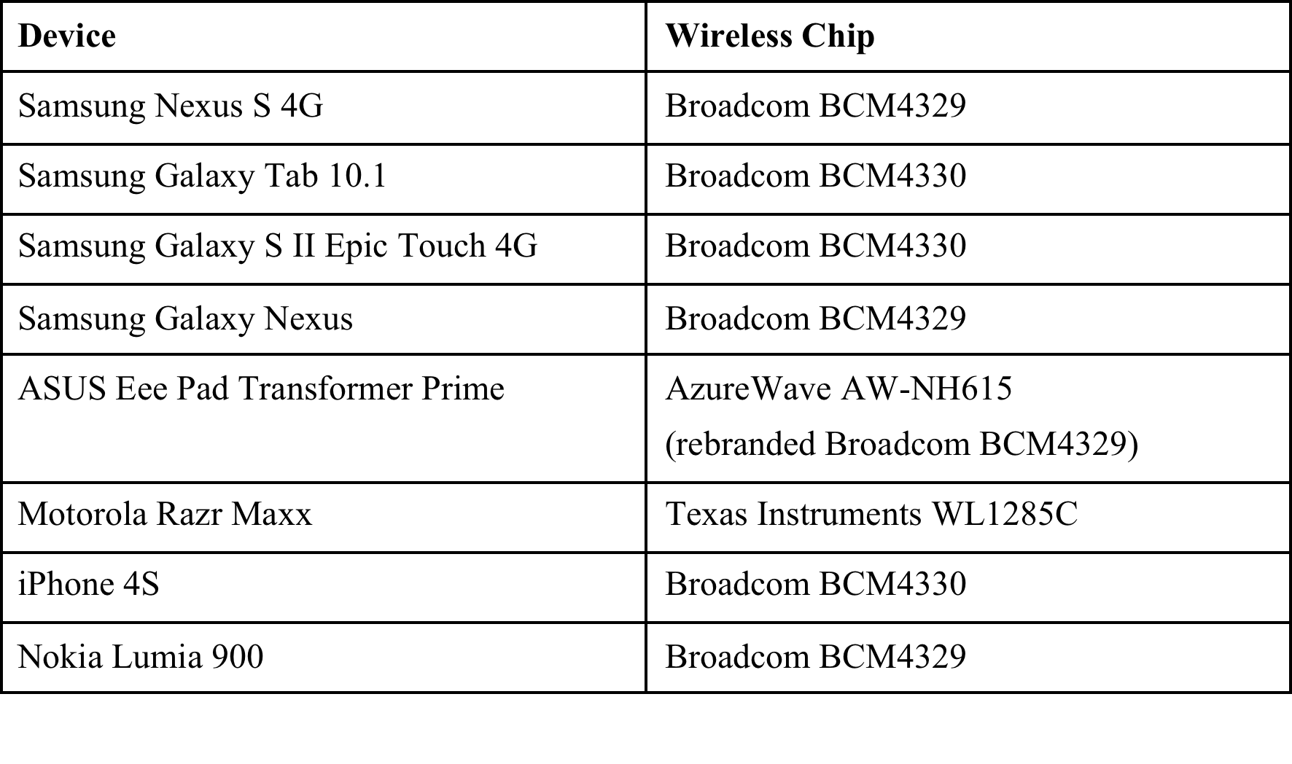
Why we love Broadcom
Flipping chipsets into Ad-Hoc Mode
Notes:
Stoker

Slide 14
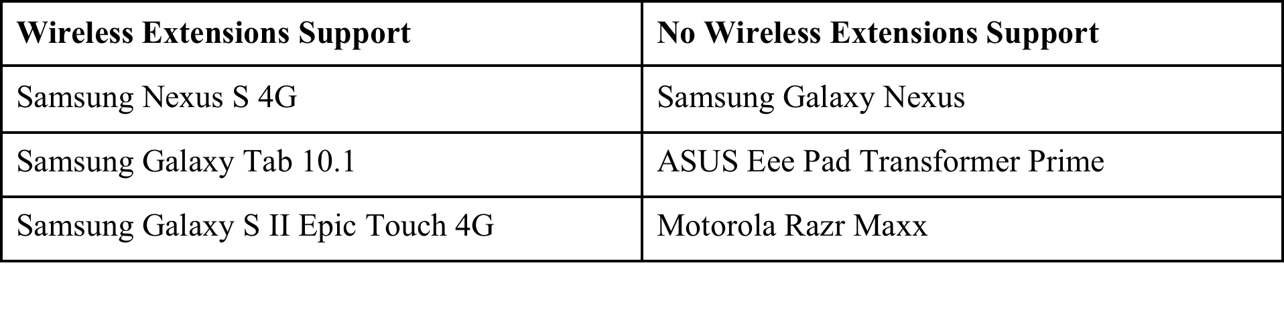
Kernel v. Metal
Dear Vendors: Please either stop mucking with your kernel source or provide it to the community
Notes:
Stoker

Slide 15
Ad-hoc Mode
Leveraged Wi-Fi Tether for Root Users app.
Edify script for setting up ad-hoc mode using cross-compiled iwconfig
Some phone wi-fi drivers don’t support ad-hoc mode
Wi-Fi Tether app. switched to using softAP
softAP: software enabled portable wireless access point
Needed to compile Wireless Extensions support into kernel
Compiled vendor open source software
Dumped zImage and drivers to AnyKernel tree
Flashed using ClockworkMod Recovery
https://github.com/koush/AnyKernel
Notes:
Stoker
Used arm cross compiler and Linux menuconfig
Wi-Fi modes: Ad-Hoc, Managed, Master, Repeater, Secondary (repeater), Monitor, or Auto

Slide 16
Why we love Broadcom
Flipping chipsets into Ad-Hoc Mode
Notes:
Stoker

Slide 17
Kernel v. Metal
Dear Vendors: Please either stop mucking with your kernel source or provide it to the community.
Notes:
Stoker

Slide 18
Where are my packets?
Android <= 4.0 (ICS) devices filter out UDP broadcasts when the screen is off
WifiManager.WifiLock doesn’t help
First approach: Force screen to always stay dimmed even when user presses power button
Create wakelock
powerManager.newWakeLock(PowerManager.SCREEN_DIM_WAKE_LOCK | PowerManager.ACQUIRE_CAUSES_WAKEUP, “ADHOC_WAKE_LOCK”)
Register an IntentFilter for Intent.ACTION_SCREEN_OFF
Acquire wakelock when intent received
Notes:
Stoker
Could receive TCP just fine

Slide 19
Where are my packets?
Second approach: Set dhd_pkt_filter_enabled=0 when loading wi-fi kernel module
Required recompiling Galaxy Nexus wi-fi driver
Notes:
Stoker

Slide 20
Plug and Play / Dynamic routing algorithms and you!
Adjusting packet routing at runtime, a 5 minute primer on untrustworthy routing tables
The tradeoffs of Bandwidth vs. Network Scale and Multi-Hop headaches
File share, Chat, Disconnected Twitter and VOIP over a Mesh. Oh, the fun we can have.
Notes:
Next 10 minutes overview slide

Slide 21
This slide should not be needed
What do I use a network for?
Chat
Data and file sharing
VoIP
Situational Awareness and Crisis management
Disconnected Twitter
Notes:
m0nk?

Slide 22
Ad-Hoc Network Routing 101
Why BATMAN is better than OLSR?
Notes:
m0nk?

Slide 23
Definitions
D
D
Topology
A
B
A
B
D
C
C
A
B
Route to 2-hop
neighbor
Route to
1-hop neighbor
C
Notes:
Stoker
Directed vs. non-directed
A route consists of edges

Slide 24
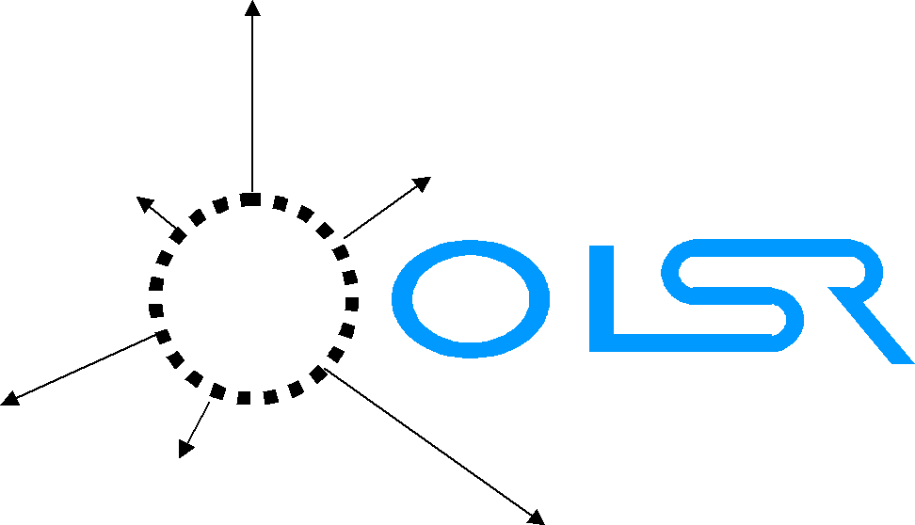
Optimized Link State Routing Protocol (2003)
Link-state protocol
Nodes know who they can talk to
Each node calcs entire route to every other node
Proactive
Routes periodically planned in advance
Kernel-level routing table modified on-the-fly
Dijkstra Open Shortest Path First algorithm
Layer 3 in OSI stack
http://www.ietf.org/rfc/rfc3626.txt
Notes:
Stoker
No special network API required since kernel-level routing table is modified
Nodes only share edge info, not routes

Slide 25
Hello.A
Find 1-hop neighbors
Hello.A
Hello.A
Hello.A
A
B
Hello.A
Hello.A
Hello.A
A
B
Hello.B
Hello.A
A
B
A
B
Asymmetric Link
Asymmetric Link
A
B
Symmetric Link
Notes:
Stoker
Hello TTL=2

Slide 26
Hello.A
Find 2-hop neighbors
Hello.A
Hello.A
Hello.A
A
B
C
Hello.A
Hello.A
Hello.A
Hello.A
A
B
C
Hello.A
A
B
C
Notes:
Stoker
Hello TTL=2
Assumes B and C are symmetric neighbors

Slide 27
Multi-Point Relay
A
B
C
E
D
F
A selects B as MPR
All 2-hop nodes reachable through B
All > 1-hop routes from A will go through B
Notes:
Stoker
Hello TTL=2
Assumes B and C are symmetric neighbors
Global topology info is > 2 hops away
MPRs are not always chosen if network is small

Slide 28
OLSR
Pros
Better than everyone sharing everything
Topology info dumps only between MPRs
Incremental improvements
Cons
MPRs are throughput choke points
Isolated points of failure
Entire routes planned in advance, but next hop doesn’t care about your route, it uses its own
Notes:
Stoker
MPRs intended to be reliable/powered/stationary nodes; not realistic in a smart-phone ad-hoc network

Slide 29

BATMAN
Better Approach to Mobile Ad-hoc Networking (2006)
Next-gen OLSR
Decentralize: No single point has all the data
No MPRs
Each node sends out originator msgs: “I exist”
Every other node keeps track of number of hops an originator msg took to reach them
http://www.open-mesh.org/projects/open-mesh/wiki/The-olsr-story
Notes:
Stoker
Also, there’s a layer 2 (ethernet) implementation: batman-adv

Slide 30
BATMAN
Simplify: Only plan first step in route
Direct packets along route with lowest originator msg. hop count
Notes:
Stoker

Slide 31
Where Are We Today?
OLSR still the most popular
BATMAN gaining traction
We can do better and so can you
If you are working in the space, please email us.
Notes:
Stoker

Slide 32
Smart Phones Have Sensors!
Battery
Don’t send packets to phones going dead
Send more packets to phones plugged in
GPS
Form routes to phones closer to you
Form routes to phones that don’t move often
Accelerometer
Don’t send packets to phones in motion
Predict phone movement and send packets to phones moving in the right direction
Notes:
m0nk

Slide 33
Reactive Protocols
Stale routing table = What routing table?
No we can play with motion and location in a useful way
Don’t forget that if you pack node location into the headers it can been seen by others
Downsides come with throughput issues
Notes:
m0nk & Stoker

Slide 34
An aside on Delay tolerance
Disconnected nodes act as disjoint message queues
The protocol thinks of the device as a carrier pigeon (RFC 2549)
Fall back to message passing
Notes:
m0nk

Slide 35
Scale, Delay and Hopping
Though we see great improvements, simple proactive routing uses a ton of bandwidth to stabilize the network
Still, we can predict bandwidth and throughput metrics
VoiP good until we scale quite large
Reactive routing has less chatter with the same bandwidth but is laggy
Mix them FTW.
Notes:
m0nk & Stoker

Slide 36
More Tunnels and some preliminary Security
Jumping over the cell network or Wi-Fi (Mimicking VPN with standard Tunnels)
Tunneling the mesh through the Internets!
VPN clusters and remote enclaves
Securing the mesh from unwanted guests
Jumping through unsecured mobile nodes
Notes:
Next 10 minutes overview slide

Slide 37
Jumping over the cell network or Wi-Fi
Your phone has at least 2 network ports (Wi-Fi & Cell):
We can connect them
We can bridge them
Tablet with no cell chip?
Plug in an ALFA wireless USB dongle
Virtual mesh networks connected using simple VPN tunnels
Notes:
m0nk & Stoker

Slide 38
IP Address Assignment
Static IP assignment
Generate a unique IP based on phone MAC address, IMEI, etc.
DHCP requires a server or global knowledge of IPs in use
Notes:
Stoker

Slide 39
A Security Paradigm?
Use Bluetooth or NFC to Bump transfer configuration info and keys
Secure each link / node with its own keys
Encrypt network data such that bounce or hop nodes cannot decrypt
Notes:
m0nk & Stoker

Slide 40
Security
Share symmetric key in config file distributed in-person via NFC
Symmetric encryption using P2P Diffie-Helman key exchanges
Asymmetric encryption using public / private key pair
A third party certificate authority isn’t practical
Notes:
Stoker

Slide 41
Security
Serval public keys double as network addresses
256-bit Curve25519 public keys based on the CryptoBox NaCl crypto library
Network intrinsically distributes keys!
Uses CryptoBox authenticated encryption for unicast traffic
Uses CryptoSign verified signing for publicly readable broadcast traffic
CryptoSign uses a handwritten sign to confirm identity
http://servalpaul.blogspot.com/2012/04/making-security-simple.html
Notes:
Stoker

Slide 42
ICS & Wi-Fi Direct: android.net.wifi.p2p API
“Provides classes to create peer-to-peer (P2P) connections over Wi-Fi Direct”
Initial ICS drop is a very lame partial implementation of the spec
Kind of works like Bluetooth pairing
Wi-Fi doesn’t support connecting to an AP and P2P at the same time
Possible upgrade in JB?
Notes:
Stoker
Turn on Wi-Fi direct and immediately disconnected from AP
“internet of Things”
Wi-Fi direct spec states that Wi-Fi chips will be able to send packets using multiple MAC addresses at once

Slide 43
Root required
Need root to modify iptables / routing tables
Need root to mess with Wi-Fi driver and put phone in ad-hoc mode
Grab Zerg, wrap in APK and pop the phone on install
Over the Air install?
Notes:
m0nk + Stoker

Slide 44
What about my…?
A:
iPhone: In Theory
Black Berry: Maybe?
Windows Phone: Yes (why do you own one?)
Arduino / GumStix: Yes
Netbook / Linux / Mac / Windows Box: Yes
Toaster: Yes but Why?
Framework is a mix of Java and C
If your box can run those…
Notes:
m0nk

Slide 45
iOS?
Apple gave us a built in Wi-Fi proxy configurable with the iPhone Configuration Utility
Ooohhh, is that an APN setting as well?
Cool, now all we need is a simple server to proxy and route our data
Notes:
m0nk

Slide 46
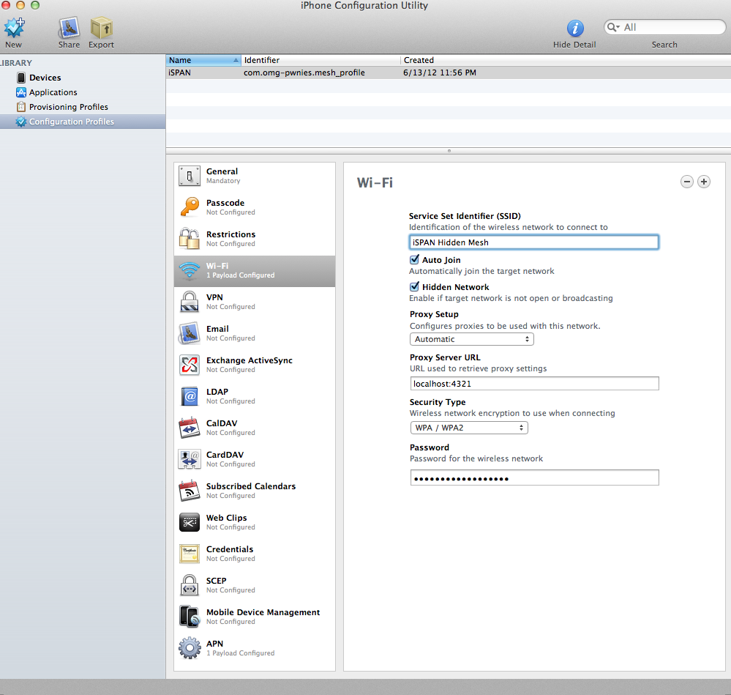
Notes:
m0nk

Slide 47
What else can we use the Mesh for?
Mobile data redundancy using the Torrent protocol to raid data across all devices?
Distribute threads and tasks across a cloud of unused processors?
Spoofing?
Notes:
m0nk

Slide 48
Similar Projects
Collaboration?
Notes:
Stoker
Also based on Wireless Tether for Root Users app.

Slide 49

Freifunk
German for "Free radio”
Non-commercial open grassroots initiative to support free open radio networks in Germany
Offers specialized OpenWrt-firmware
Routing based on OLSR or BATMAN
Freifunk Berlin has 500+ nodes
http://berlin.freifunk.net/
http://wiki.freifunk.net/
Notes:
Stoker
Users register for a Freifunk Berlin IP using an online webform

Slide 50

Android ad-hoc network framework
Implemented features
VOIP calls between Serval Mesh-enabled phones
MeshMS, free mesh-based SMS
Features under development
Serval Rhizome, distributed mesh-based data distribution platform
Serval Maps, mesh-based mapping application
Serval Morse, distributed micro-blogging service
A simple API for using Serval services
http://www.servalproject.org/
Notes:
Stoker
Also based on Wireless Tether for Root Users app.
Dr. Paul Gardner-Stephen
Also called batphone

Slide 51
Future Work
VOIP over the mesh
IP address assignment
Evaluate and improve Serval’s approach to security
iOS and Windows 8 port
Notes:
Stoker
Servers are bad in a P2P network
IMEI: International Mobile Equipment Identity

Slide 52
Dumb enough to attempt a demo!
Oh wait, we already did?
Notes:
Stoker

Slide 53

Shameless Plug
GitHub repo:
https://github.com/monk-dot
Notes:
Stoker

Slide 54
Open Source Projects Used
Wireless Tether for Root Users
“This program enables tethering (via wifi) for rooted handsets.”
http://code.google.com/p/android-wifi-tether/
olsrd
“An adhoc wireless mesh routing daemon”
http://www.olsr.org/
monoutil
“A simple tool for network monitoring” using netfilter
http://code.google.com/p/monoutil/
Processing for Android
“Processing is a language and environment for people who want to create images, animations, and interactions.”
http://wiki.processing.org/w/Android
Linux: iwconfig, iptables, dnsmasq, tcpdump, etc.
Notes:
Stoker

